Slide 1
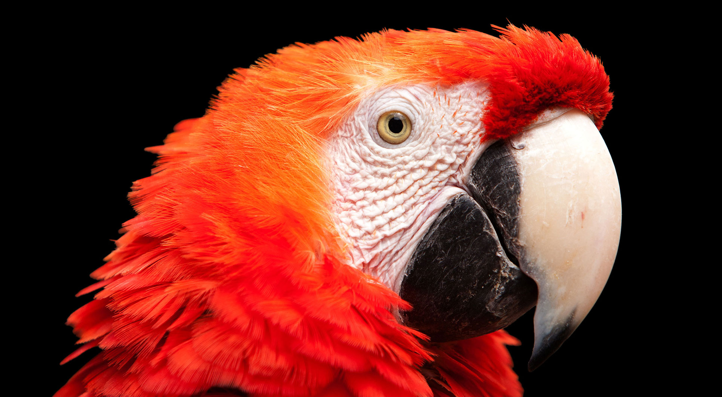
10.4 蛇扭动动画
《Python青少年趣味编程》
小牛叔出品

Slide 2
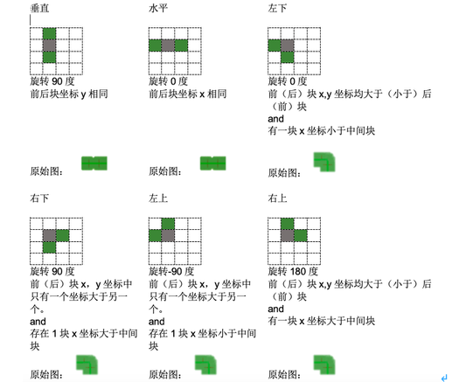
1、图片旋转方向确定

Slide 3
2、得到蛇身的图片
def getBodyImage(self,index):
snakeBody = pygame.image.load('snake_body_h.png') #身
snakeTurn = pygame.image.load('snake_turn.png') #身
if self.snakeLine[index-1][0] == self.snakeLine[index+1][0]:
#x坐标相同就是垂直身体
return pygame.transform.rotate(snakeBody,90)
elif self.snakeLine[index-1][1] == self.snakeLine[index+1][1]:
#y坐标相同就是水平的身体
return snakeBody
else:
#是否x,y坐标同时大于另一块
slope = (self.snakeLine[index-1][0] - self.snakeLine[index+1][0])/(self.snakeLine[index-1][1] - self.snakeLine[index+1][1])
#是否存在一块x坐标大于中间块
right = max(self.snakeLine[index-1][0],self.snakeLine[index+1][0]) > self.snakeLine[index][0]
if slope>0 and right:
return pygame.transform.rotate(snakeTurn,180)
elif slope>0 and not right:
return snakeTurn
elif slope<0 and right:
return pygame.transform.rotate(snakeTurn,90)
elif slope<0 and not right:
return pygame.transform.rotate(snakeTurn,-90)
return None

Slide 4
3、蛇头与蛇尾判断
if index == 0 or index == len(self.snakeLine)-1: #如果是第0或最后一块
#前面的块
before = self.snakeLine[0] if index==0 else self.snakeLine[-2]
#后面的块
after = self.snakeLine[1] if index==0 else self.snakeLine[-1]
offX = before[0] - after[0]
offY = before[1] - after[1]
if (offX==30 or offX==-870) and offY==0:
return Snake.snakeHead if index ==0 else Snake.snakeTail
elif (offX==-30 or offX==870) and offY==0:
return pygame.transform.rotate(Snake.snakeHead if index ==0 else Snake.snakeTail,180)
elif offX==0 and (offY==30 or offY==-570):
return pygame.transform.rotate(Snake.snakeHead if index ==0 else Snake.snakeTail,-90)
elif offX==0 and (offY==-30 or offY==570):
return pygame.transform.rotate(Snake.snakeHead if index ==0 else Snake.snakeTail,90)

